Slide 1
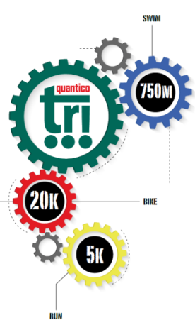
Saturday, August 25, 2018
Swim start area parking pass

